Slide 1
#Fcuk
Cancer

Slide 2

https://bit.ly/Make_My_Report_Pop

Slide 3


Slide 5
Make my report pop - using psychology, physiology, and design to create dazzling reports

Slide 6
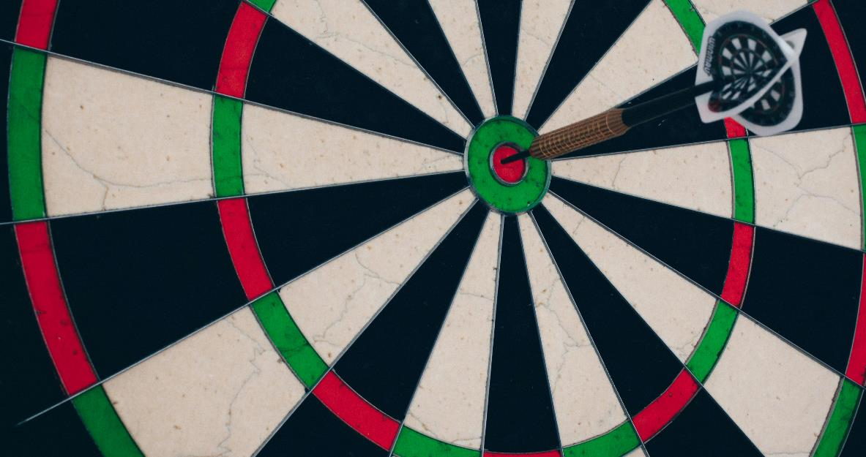
Notes:
Photo by Silvan Arnet on Unsplash
What is our goal with this session?

Slide 7
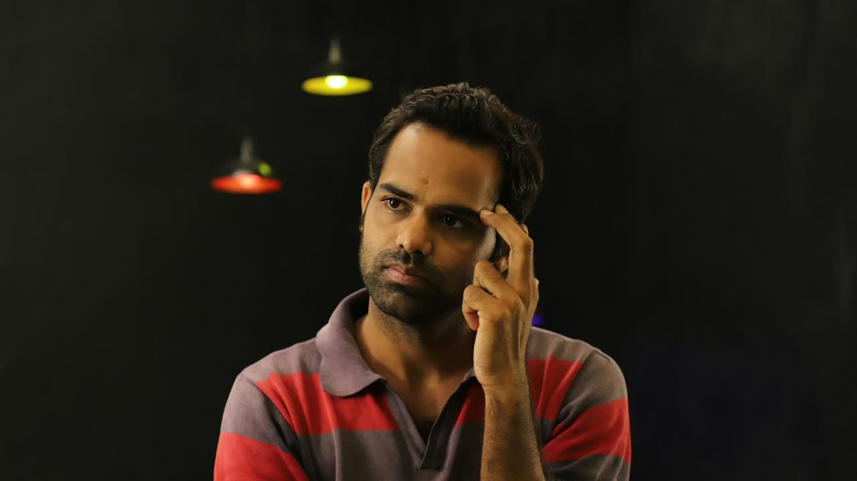
Notes:
Photo by jaikishan patel on Unsplash
Get you to think look a things in a different way

Slide 8
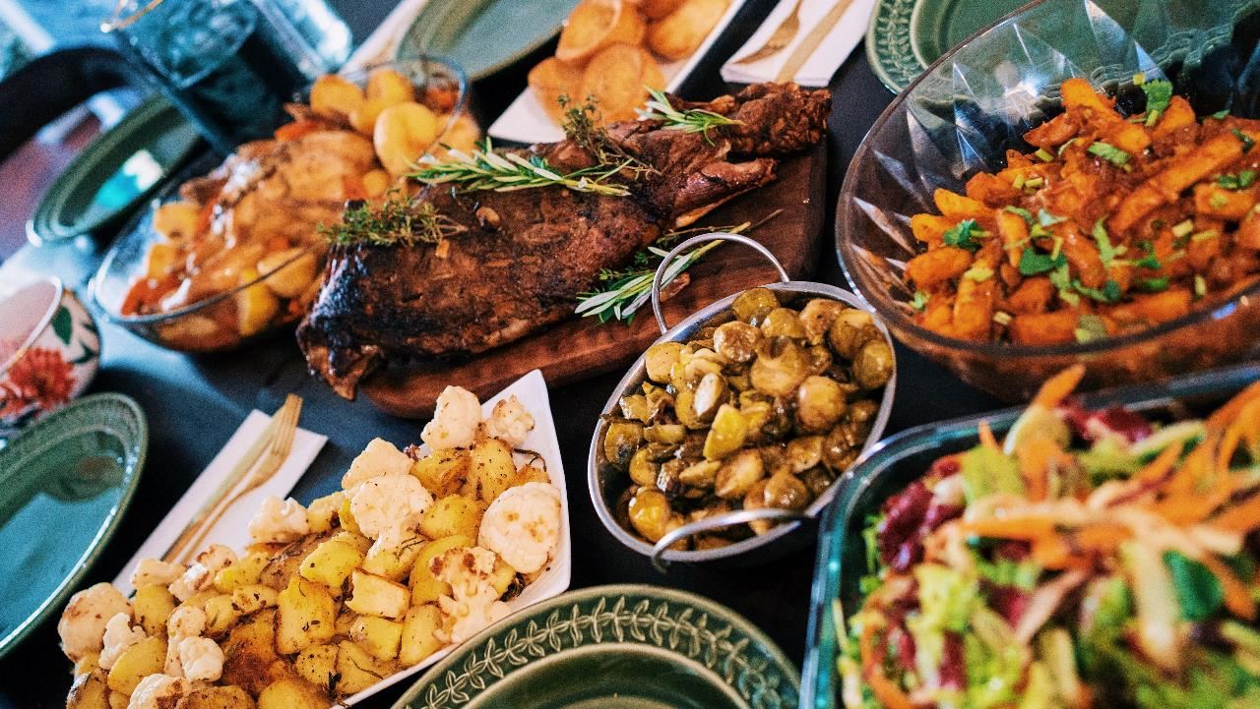
Notes:
This is session is more a buffet please take from it what you want.
Take what you want, what appeals to you
Photo by <a href="https://unsplash.com/@rumanamin?utm_content=creditCopyText&utm_medium=referral&utm_source=unsplash">Rumman Amin</a> on <a href="https://unsplash.com/photos/assorted-type-foods-nKs-oXRGGEg?utm_content=creditCopyText&utm_medium=referral&utm_source=unsplash">Unsplash</a>

Slide 9
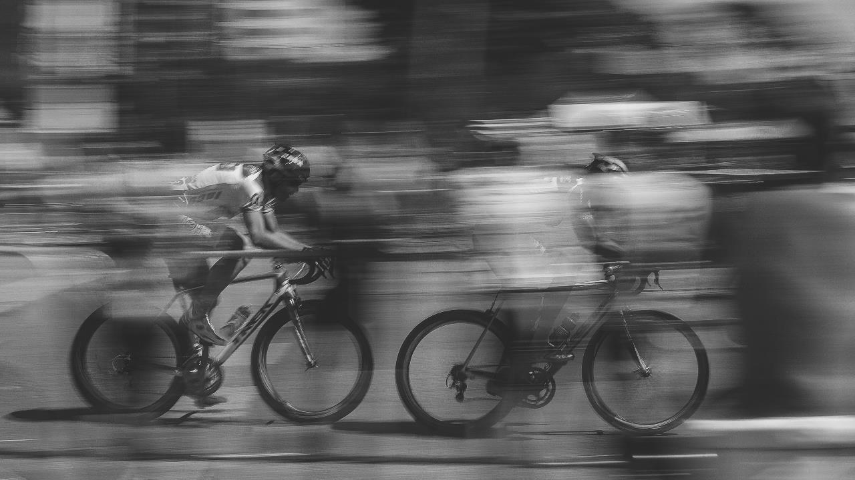
Notes:
Photo by Maico Amorim on Unsplash
This session is going to go very fast we have a lot of talk about

Slide 10

Notes:
Photo by Daniel Jensen on Unsplash

Slide 11

Notes:
Photo by Towfiqu barbhuiya on Unsplash

Slide 12

Notes:
Photo by Rainer Bleek on Unsplash
Where did the inspiration for this course come from?

Slide 13

Notes:
Photo by Ugur Akdemir on Unsplash
I read a lot of books

Slide 14

Notes:
Photo by Souvik Banerjee on Unsplash

Slide 15
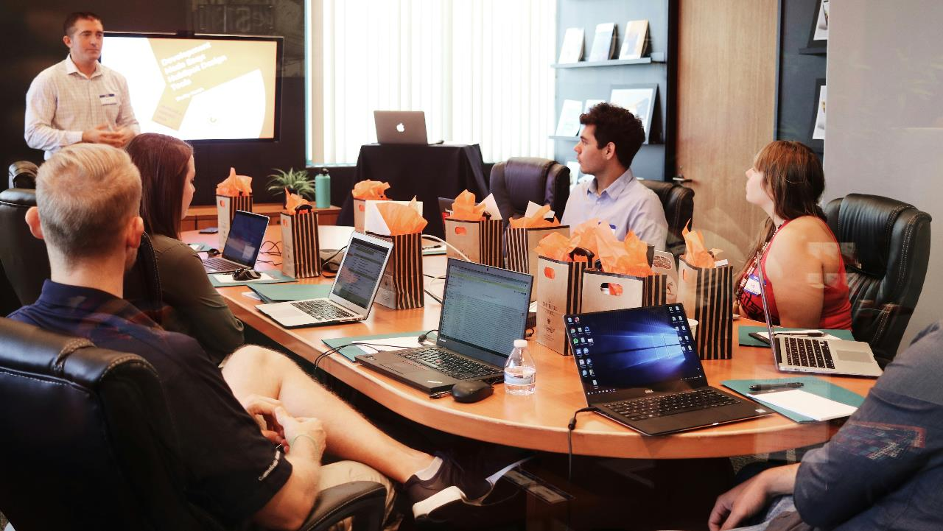
Notes:
Photo by Campaign Creators on Unsplash
Also doing a variety of training courses as well

Slide 16

Notes:
Photo by Brett Jordan on Unsplash
Over my time of training, reading, trying different, techniques we have found various techniques and ideas that work.

Slide 17

Notes:
Data visualizations is creating visuals like this or other thing
Photo by <a href="https://unsplash.com/@lukechesser?utm_content=creditCopyText&utm_medium=referral&utm_source=unsplash">Luke Chesser</a> on <a href="https://unsplash.com/photos/graphs-of-performance-analytics-on-a-laptop-screen-JKUTrJ4vK00?utm_content=creditCopyText&utm_medium=referral&utm_source=unsplash">Unsplash</a>

Slide 18

Notes:
Art
Photo by <a href="https://unsplash.com/@russn_fckr?utm_content=creditCopyText&utm_medium=referral&utm_source=unsplash">russn_fckr</a> on <a href="https://unsplash.com/photos/assorted-color-paints-krV5aS4jDjA?utm_content=creditCopyText&utm_medium=referral&utm_source=unsplash">Unsplash</a>

Slide 19

Notes:
Science
Photo by <a href="https://unsplash.com/@cheaousa?utm_content=creditCopyText&utm_medium=referral&utm_source=unsplash">Ousa Chea</a> on <a href="https://unsplash.com/photos/white-microscope-on-top-of-black-table-gKUC4TMhOiY?utm_content=creditCopyText&utm_medium=referral&utm_source=unsplash">Unsplash</a>

Slide 20

Notes:
Photo by Suzy Hazelwood: https://www.pexels.com/photo/notebook-1226398/
So what are we going to talk about today?

Slide 21

Personas
Notes:
https://dribbble.com/shots/1938508-Free-User-pics

Slide 22
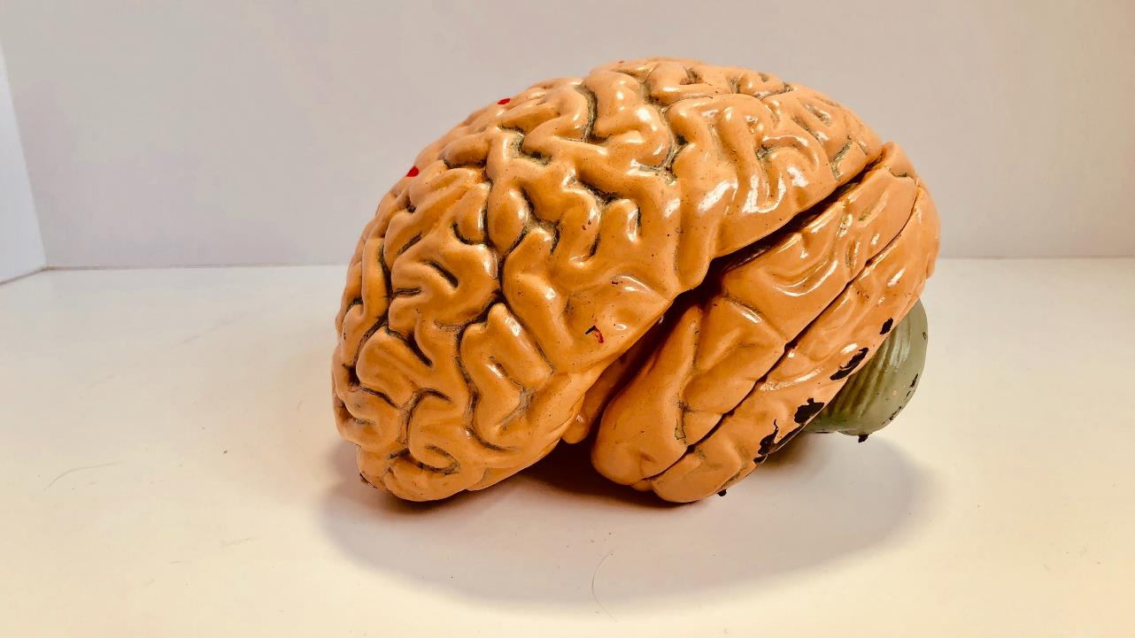
Physiology
Notes:
Photo by <a href="https://unsplash.com/@natcon773?utm_content=creditCopyText&utm_medium=referral&utm_source=unsplash">Natasha Connell</a> on <a href="https://unsplash.com/photos/human-brain-figurine-aCU6AJnT-8g?utm_content=creditCopyText&utm_medium=referral&utm_source=unsplash">Unsplash</a>
physiology

Slide 23

Notes:
Psychology
Photo by <a href="https://unsplash.com/@markuswinkler?utm_content=creditCopyText&utm_medium=referral&utm_source=unsplash">Markus Winkler</a> on <a href="https://unsplash.com/photos/a-close-up-of-a-typewriter-with-a-paper-on-it-_dICL6joLRk?utm_content=creditCopyText&utm_medium=referral&utm_source=unsplash">Unsplash</a>

Slide 24

Notes:
Photo by Ben Wicks on Unsplash
Colour theory

Slide 25

Design
Notes:
Photo by picjumbo.com: https://www.pexels.com/photo/blue-pen-beside-black-smartphone-on-white-paper-196646/

Slide 26
Fonts
Fonts
Fonts
Fonts
Fonts
Who gives a font about fonts?

Slide 27

Notes:
Photo by Ann H: https://www.pexels.com/photo/do-text-on-dice-15387085/
Want you to do something for me

Slide 28

Notes:
Photo by Fredy Jacob on Unsplash

Slide 29
https://bit.ly/Make_My_Report_Pop

Slide 30

Notes:
Photo by Dim Hou on Unsplash

Slide 31
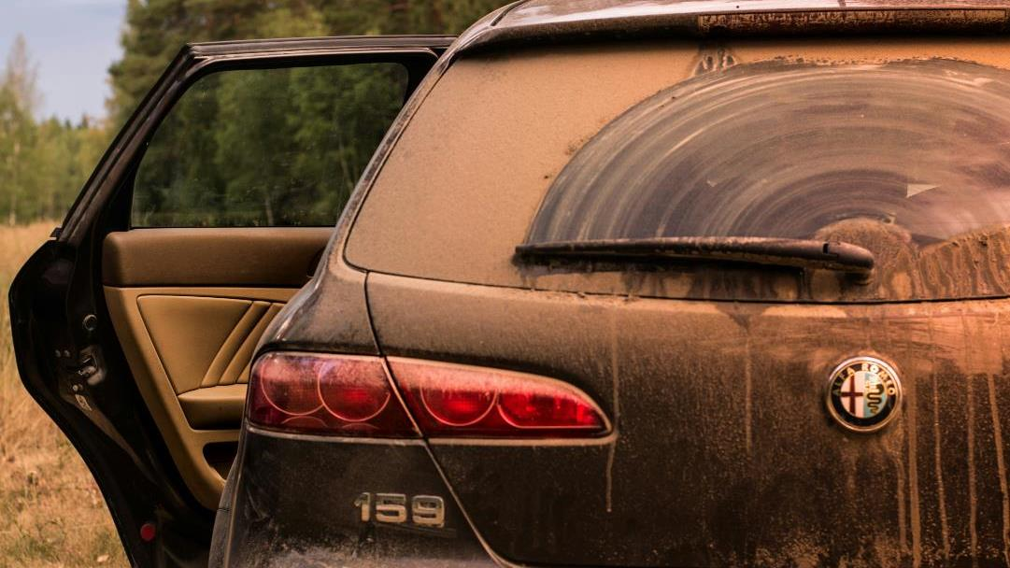
Notes:
Photo by Colton Sturgeon on Unsplash
If you have dirty data then need to sort it out that’s not part of our presentation

Slide 32




Notes:
Photo by Alen Kajtezovic on Unsplash
Photo by Arnold Mécses on Unsplash
Photo by Alen Kajtezovic on Unsplash
Photo by David von Diemar on Unsplash Photo by Victor Constantinovic on Unsplash
Photo by Rafal Gerent-Pocian on Unsplash
Photo by Cédric Streit on Unsplash

Slide 33

Koen Verbeeck
Notes:
Photo by <a href="https://unsplash.com/@rubaitulazad?utm_content=creditCopyText&utm_medium=referral&utm_source=unsplash">Rubaitul Azad</a> on <a href="https://unsplash.com/photos/text-CMFglgJg3d4?utm_content=creditCopyText&utm_medium=referral&utm_source=unsplash">Unsplash</a>
If you do not know how to create a star schema then investing the time is worth it

Slide 34

Your Feedback IS WANTED
https://sqlb.it/?11622

Slide 35

Sponsors

Slide 36




Olivia Wise
BI Consultant with Quorum
Lives in Rainy Glasgow, Scotland
olivia.wise@quorum.co.uk
https://www.linkedin.com/in/olivia-wise/
https://www.qnrl.com/

Slide 37




Robert French
Chief Power BI Nerd with Quorum
Lives in Sunny Glasgow, Scotland
Rwlp.French@gmail.com
@sqlbobscot
@sqlbobscot@techhub.social
https://www.linkedin.com/in/rwlpfrench/
https://www.qnrl.com/

Slide 38

Managed Services | Projects & Professional Services
Modern Workplace Secure Remote Work
Productivity & Teamwork
Security & Governance
Cloud
Platform Adoption & Migration
DevOps Engineering
Cloud Innovation
Data, Analytics & AI Data Platform
Business Intelligence
AI and Machine Learning
Business Apps & Development
Power Platform
Application Modernisation
Cloud Development
Security, Compliance & Identity Identity as a Service | Multi-Factor Authentication | Device Management | Threat Management | Information Protection | Application Security
Strategy | Architecture | Design | Engineering | Testing | Deployment | Operations
Supporting your business through our technology solutions
DevOps | Agile | Business Change | Project Management | User Training & Education

Slide 39
Personas

Slide 40

Notes:
Photo by Hennie Stander on Unsplash
Lets start with a question

Slide 41

Notes:
Photo by Wan San Yip on Unsplash
Who is your audience
How well do you know your audience?

Slide 42

Notes:
What about sorting our audience into different categories?
Photo by Luis Quintero from Pexels

Slide 43

Notes:
Who in your audience is more comfortable with graphical concepts than numbers
Photo by Ari He on Unsplash

Slide 44
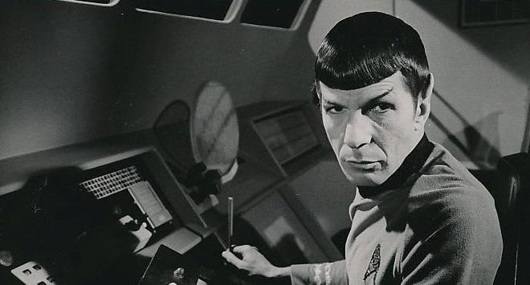
Public Domain, https://commons.wikimedia.org/w/index.php?curid=35441204
Notes:
Who is your audience is more comfortable with
By NBC Television - http://www.ebay.com/itm/SUPERB-1968-Original-Photo-LEONARD-NIMOY-as-SPOCK-in-T-V-STAR-TREK-/261594177355?pt=LH_DefaultDomain_0&amp;hash=item3ce83a5f4b, Public Domain, https://commons.wikimedia.org/w/index.php?curid=35441204

Slide 45
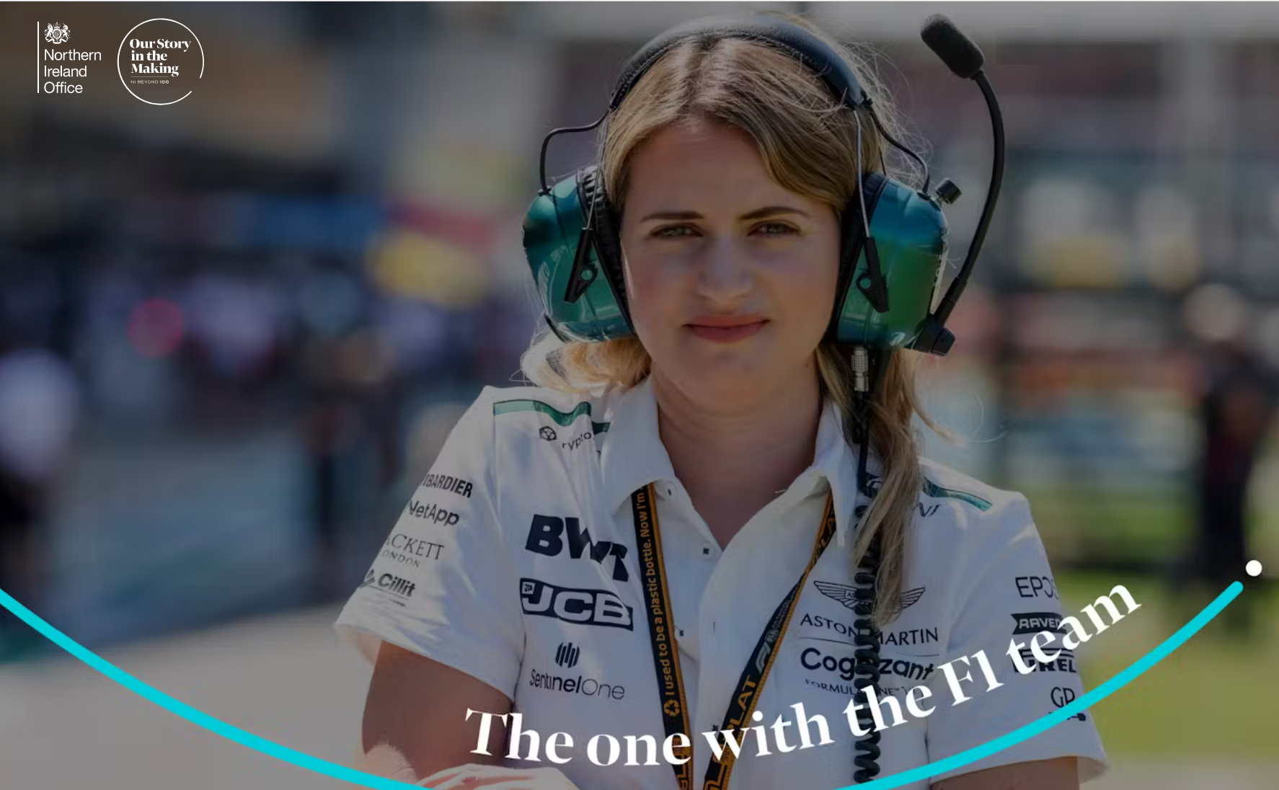
https://ourstoryinthemaking.com/stories/the-one-with-the-f1-team
Notes:
Bernadette (Bernie) Collins
Was Strategy Engineer for Aston Martin F1 team

Slide 46

Notes:
Who is uncomfortable with numbers
Photo by Nik Shuliahin on Unsplash

Slide 47

Notes:
Who is the audience - What are their data literacy levels
Are they a maths graduate
Background in Local government finance
F1 racing mechanic
Meet the inspirational women proving that F1 is ‘more than a man’s world’ (marieclaire.co.uk)
12 Top Car Racing Drivers That Happen to Be Women: 24 Hours of Daytona - Bloomberg
Artist with dyslexia
Photo by RF._.studio from Pexels

Slide 48
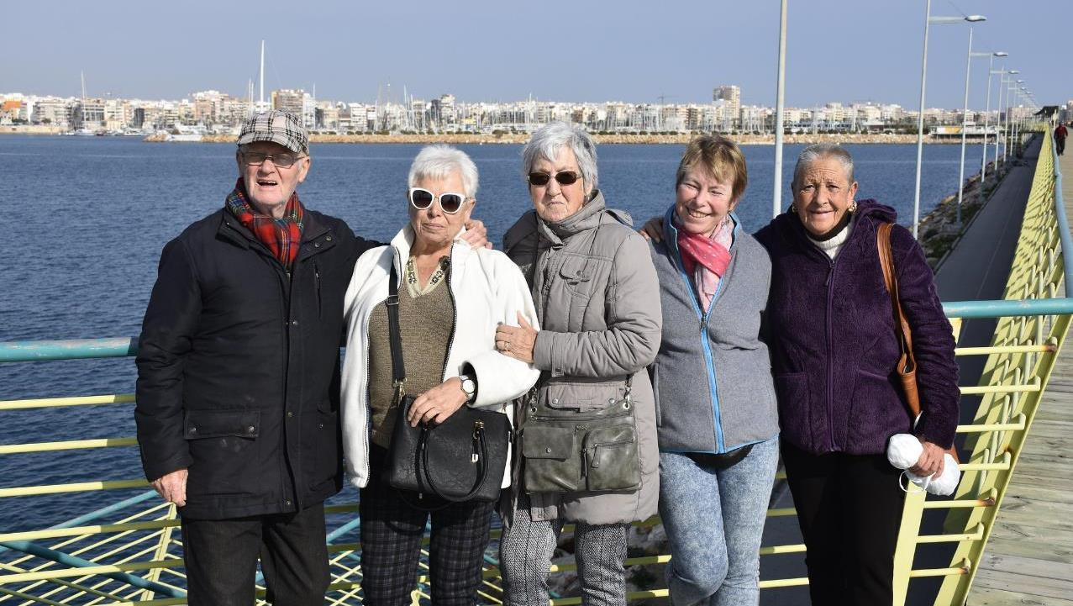
Notes:
Thinking of my parents and my partner Jan, none of them that data literate. Which only means the way that data is presented should be different.

Slide 49
205 %
more cyclists traveling into Glasgow city centre.
When compare 2009 with 2018.
https://www.understandingglasgow.com/indicators/transport/cycling

Slide 50
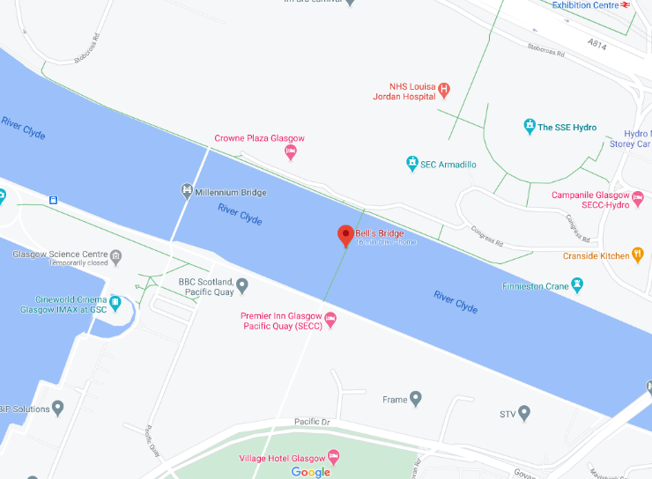
124 more cyclists using Bells Bridge during 2 day survey period in 2018 compared to same period in 2009.

Slide 51
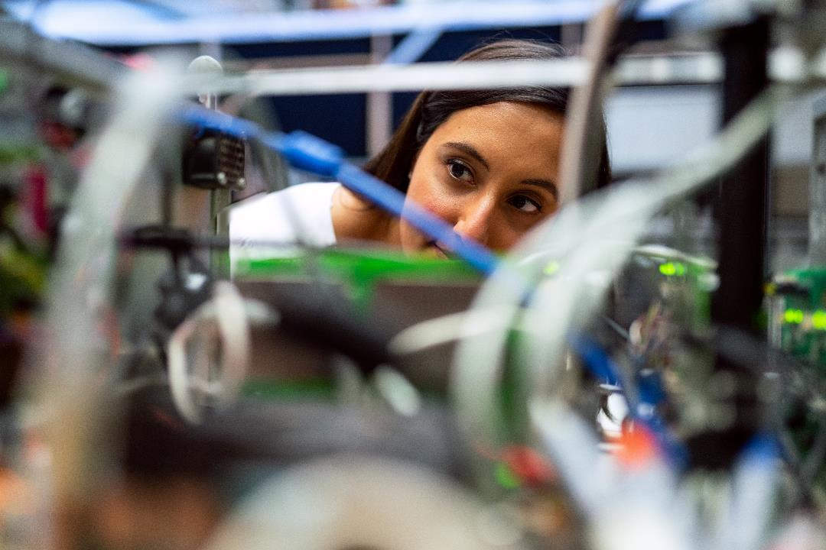
Notes:
What level of detail would an engineer want?
Photo by ThisIsEngineering from Pexels

Slide 52

Notes:
Would a visual artist be as interested in the same level of details and figures. Maybe, its context that matters .
Photo by Brett Sayles from Pexels

Slide 53

Notes:
So you have a question, Robert how do I define that audience, glad you asked!
Photo by <a href="https://unsplash.com/@rohitfarmer?utm_content=creditCopyText&utm_medium=referral&utm_source=unsplash">Rohit Farmer</a> on <a href="https://unsplash.com/photos/boy-in-white-and-red-crew-neck-t-shirt-sitting-on-chair-cYRMl1HeuVo?utm_content=creditCopyText&utm_medium=referral&utm_source=unsplash">Unsplash</a>

Slide 54
Personas
Notes:
https://dribbble.com/shots/1938508-Free-User-pics

Slide 55
“…nobody uses them…
why should we use them?”
Notes:
This might be something some people are thinking? You told about personas

Slide 56

Notes:
Some people think it’s a good idea, some do not lets look at which organisations use personas
https://www.pexels.com/photo/banking-business-checklist-commerce-416322/

Slide 57


Slide 58
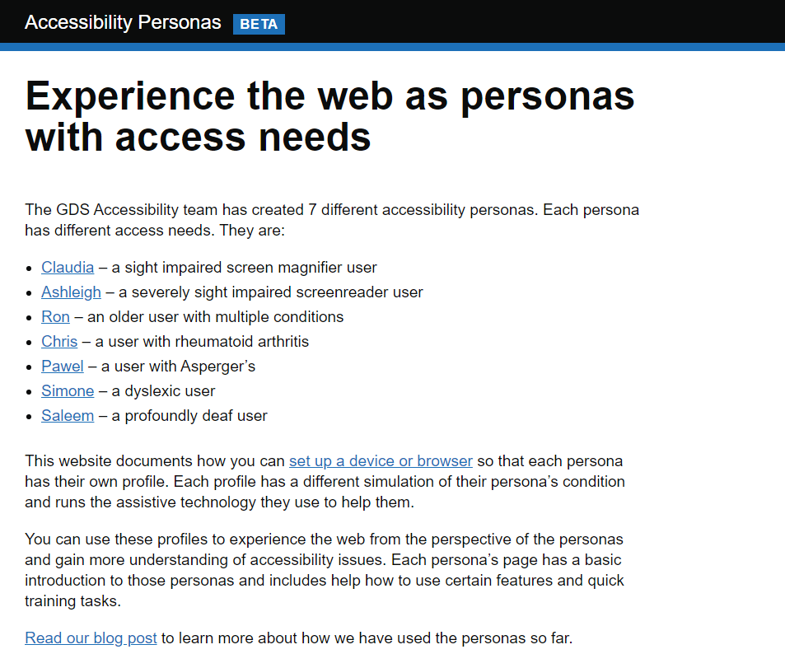
Notes:
https://alphagov.github.io/accessibility-personas/

Slide 59
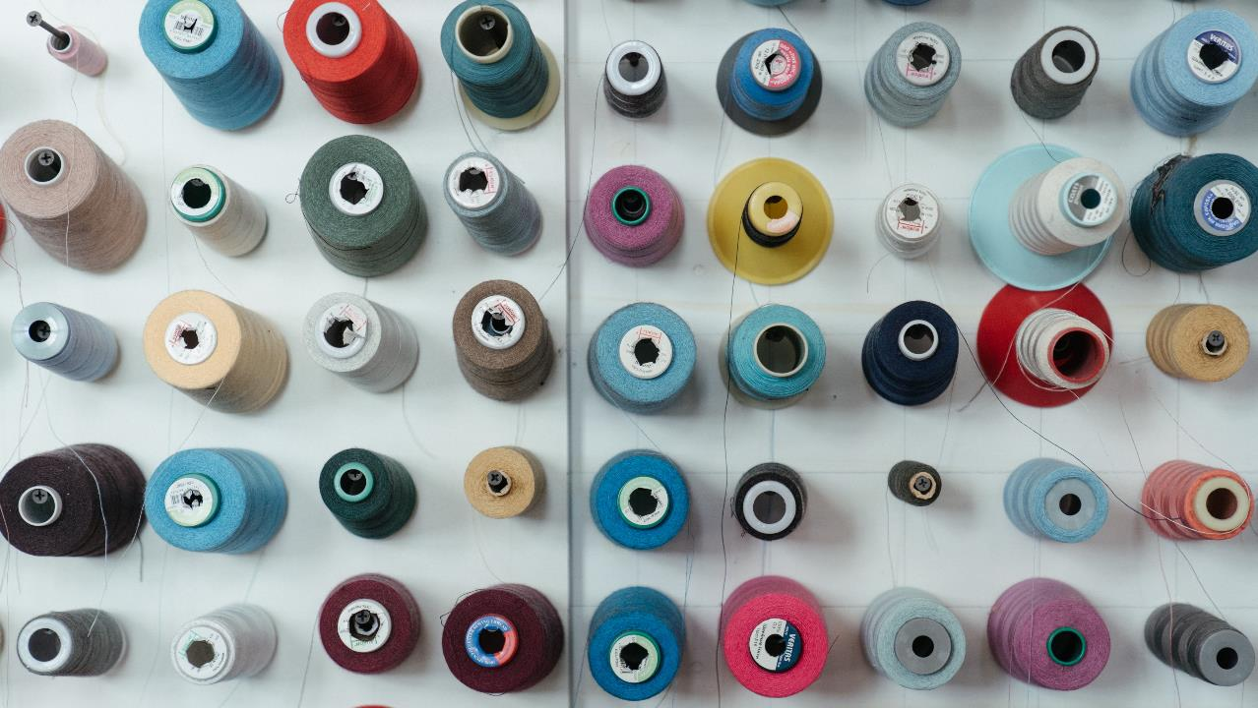
Define your audience?
Notes:
Many humans like to sort things into different categories
Photo by cottonbro from Pexels

Slide 60



Notes:
Photo by Piotrek on Unsplash
Photo by Piotrek on Unsplash
Photo by sean hall on Unsplash

Slide 61
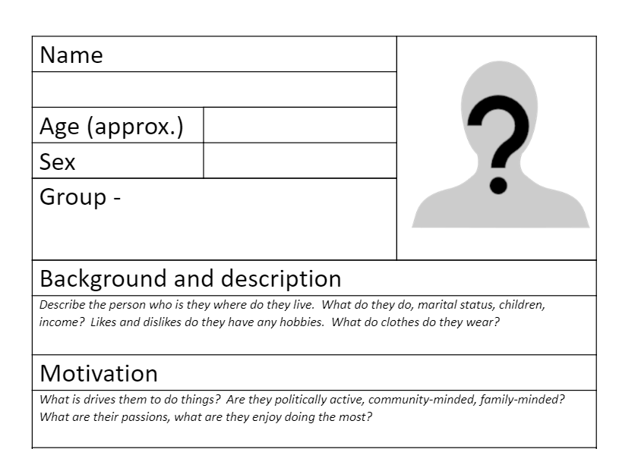
Notes:
This is an example form I use for defining personas, as a starting point

Slide 62
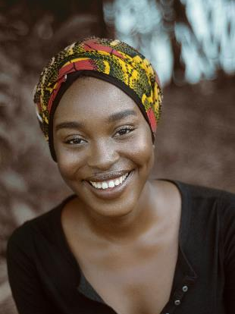

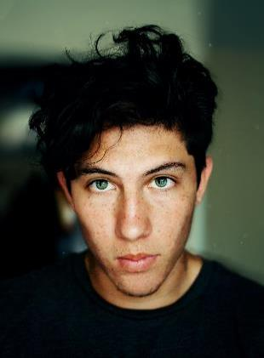
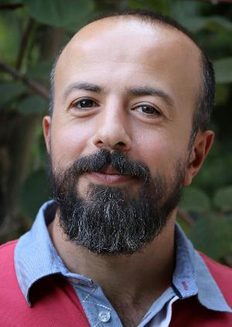

https://unsplash.com/s/photos/face
Notes:
Use photographs of really people
Photo by Reza Biazar on Unsplash
Photo by Prince Akachi on Unsplash
Photo by Imansyah Muhamad Putera on Unsplash

Slide 63

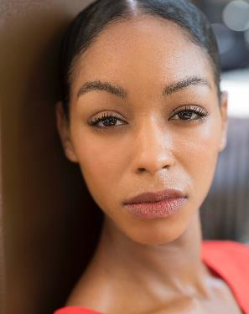


https://www.pexels.com/search/face/
Notes:
Photo by Italo Melo from Pexels
Photo by Marcus Aurelius: https://www.pexels.com/photo/woman-smiling-at-the-camera-6787567/

Slide 64
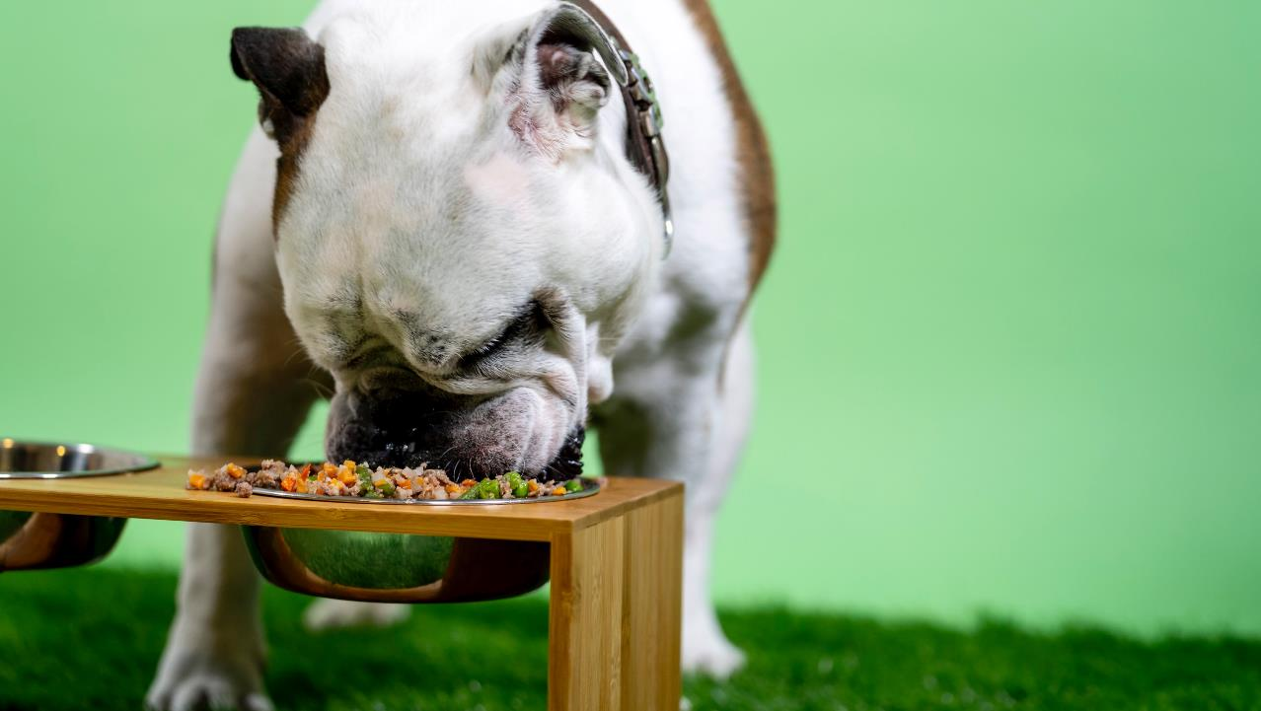
Notes:
Yes I do eat my own dog food
Photo by Kabo on Unsplash

Slide 65
"Eat your own dog food"
“Show people that you do, what you tell other people to do……"

Slide 66
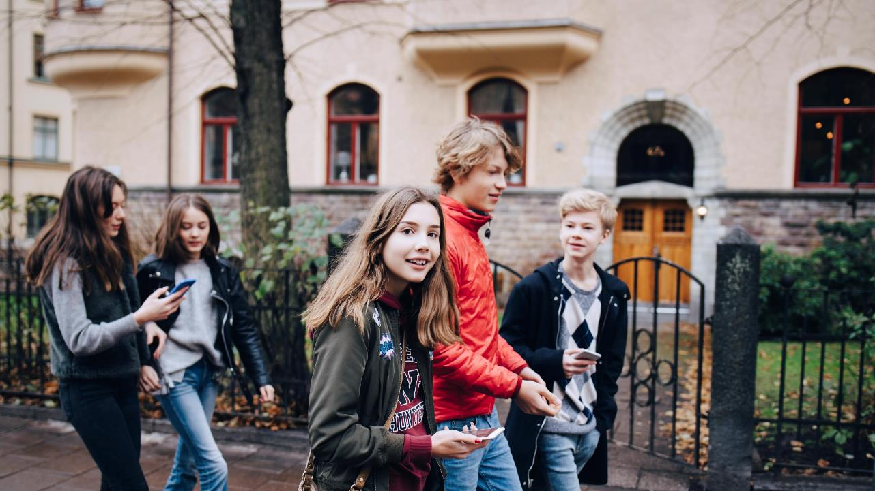
Don’t just talk the talk
Walk the Walk

Slide 67

Notes:
As in all the good cookery shows here’s is one I prepared earlier
Photo by Phinehas Adams on Unsplash

Slide 68
https://bit.ly/Make_My_Report_Pop

Slide 70
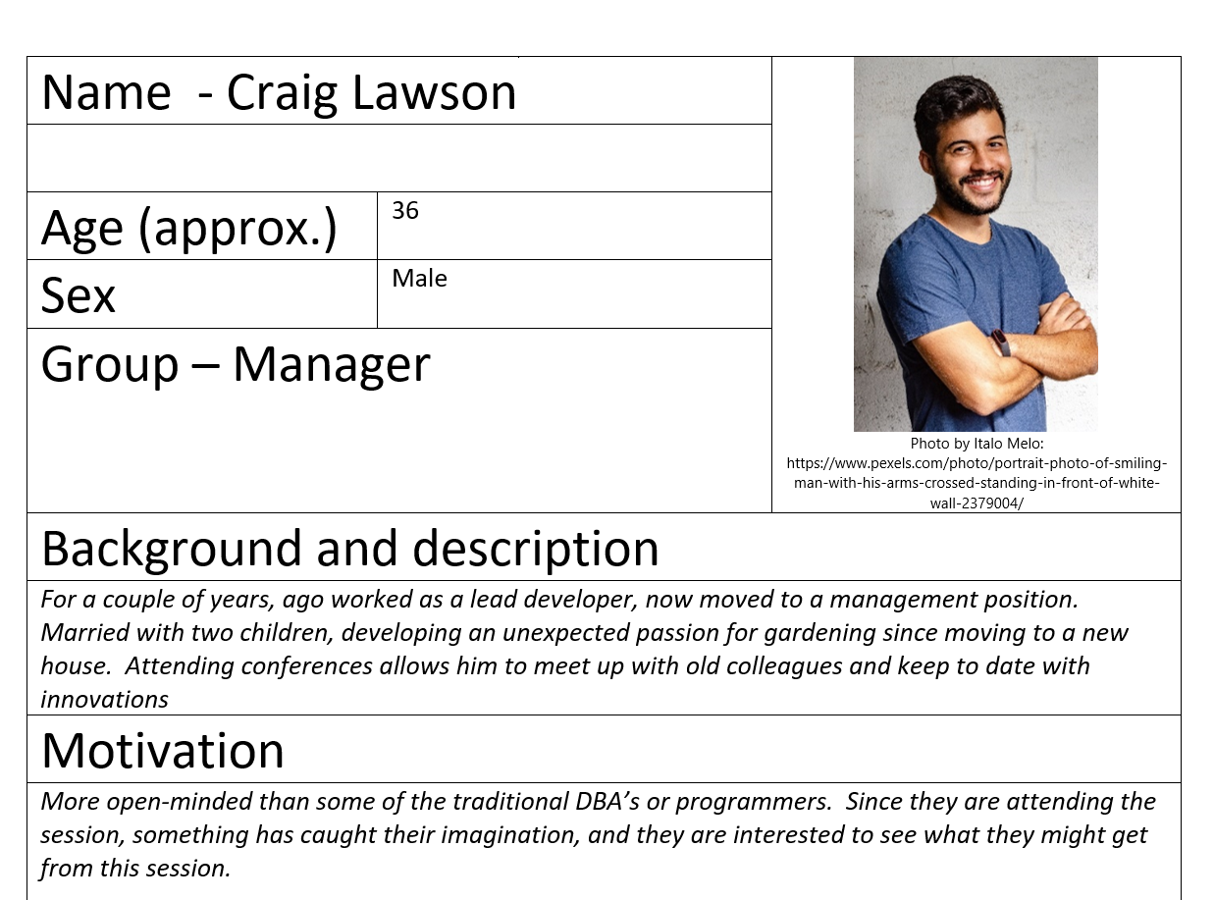

Slide 71
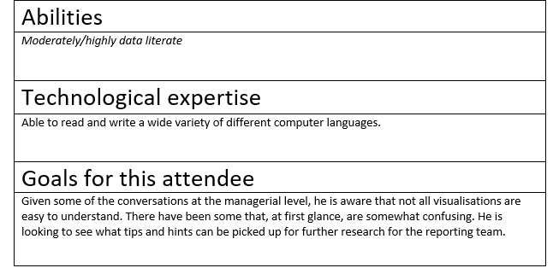

Slide 72
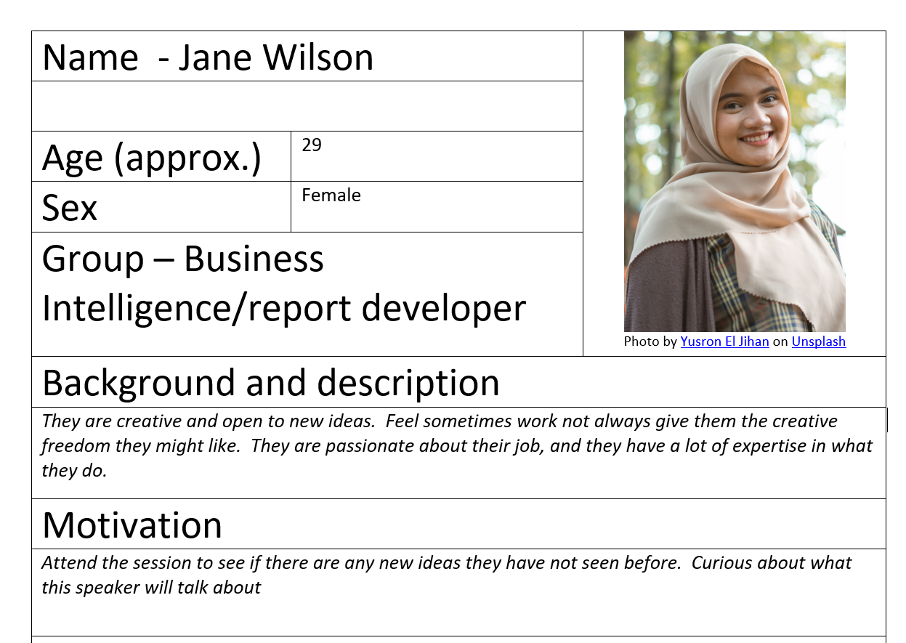

Slide 73
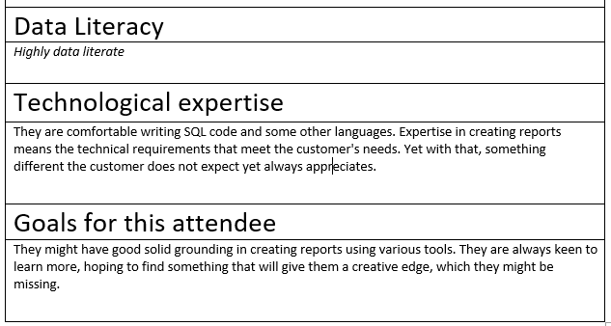

Slide 74
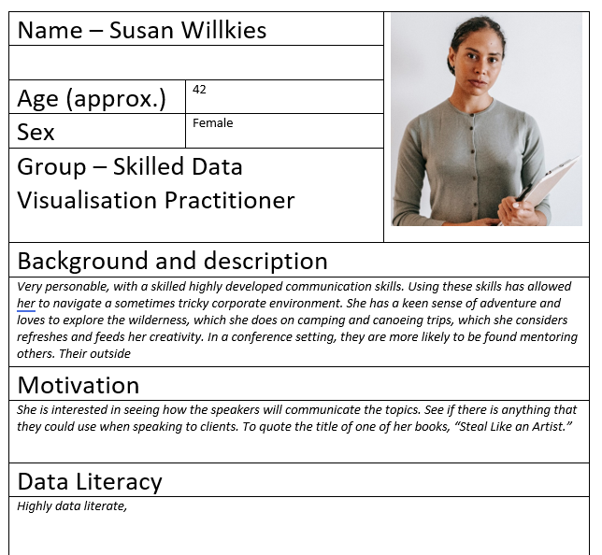

Slide 75
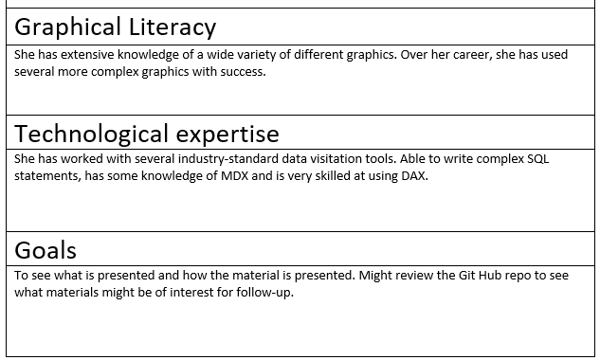

Slide 76


Which persona do you think you are like?
ⓘ Start presenting to display the poll results on this slide.

Slide 77

Notes:
Photo by Kindel Media: https://www.pexels.com/photo/woman-in-red-top-pointing-on-the-graph-7688455/
Still not convinced?

Slide 78
Sales People

Slide 79
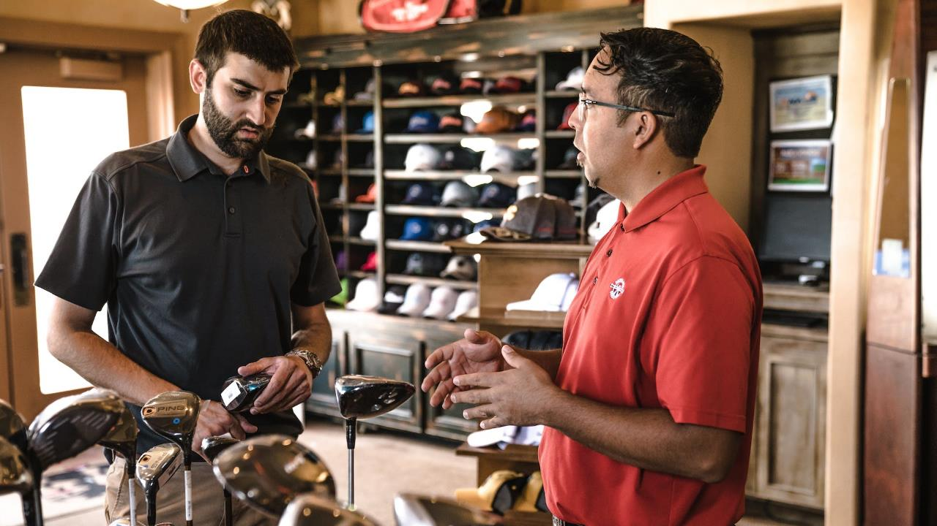
Notes:
Photo by Jopwell: https://www.pexels.com/photo/man-standing-beside-man-holding-gray-club-1325735/
We do not see sales people, we see
Steven, who helps customers find the best golf equipment, in the evenings he spends time coaching the local juniors
Married, with two children in their teens. Mondays are his day to go to the golf course and do Eighteen holes
He wants to see that his is achieving his targets that he has set himself to ensure that he can enjoy the rewards to selling the best equipment
Will only spend a couple of minutes checking the report

Slide 80
Customers

Slide 81

Notes:
Photo by Amina Filkins: https://www.pexels.com/photo/positive-multiracial-women-working-with-tablet-in-floral-store-5410070/ When Sally checks the column charts to review her energy usage, she wants to be able to understand the usage over time.
The ability to navigate and see the usage clearly is very important, as she keeps a close eye on a overheads. One of the reasons that she moved from her previous supplier was the lack of access to clear easy to access usage visuatlations

Slide 82

Notes:
Photo by <a href="https://unsplash.com/@naassomz1?utm_content=creditCopyText&utm_medium=referral&utm_source=unsplash">Naassom Azevedo</a> on <a href="https://unsplash.com/photos/group-of-people-sitting-on-bench-near-trees-duting-daytime-Q_Sei-TqSlc?utm_content=creditCopyText&utm_medium=referral&utm_source=unsplash">Unsplash</a>
We are psychological wired to consider people not abstract names for groups of people

Slide 83

Notes:
So we agree using Personas is a good idea and you are going to use them.

Slide 84

Notes:
Now what do I do with them?
Photo by <a href="https://unsplash.com/@timmossholder?utm_content=creditCopyText&utm_medium=referral&utm_source=unsplash">Tim Mossholder</a> on <a href="https://unsplash.com/photos/text-DZcZ4Kskq6U?utm_content=creditCopyText&utm_medium=referral&utm_source=unsplash">Unsplash</a>

Slide 85
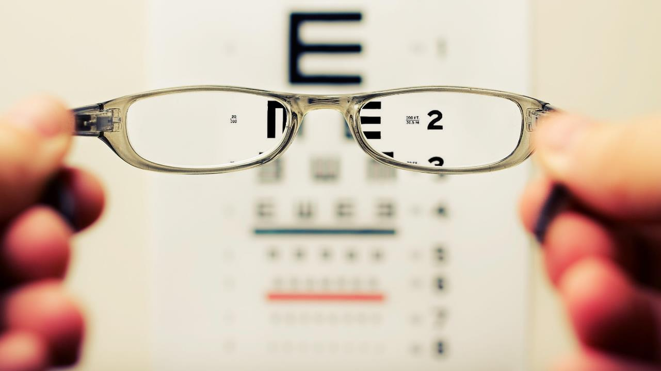
Notes:
Photo by <a href="https://unsplash.com/@dtravisphd?utm_content=creditCopyText&utm_medium=referral&utm_source=unsplash">David Travis</a> on <a href="https://unsplash.com/photos/person-holding-eyeglasses-aVvZJC0ynBQ?utm_content=creditCopyText&utm_medium=referral&utm_source=unsplash">Unsplash</a>
How does the world look when you look through some else's eyes or glasses ?

Slide 86
What should be included?

Slide 87

Notes:
Photo by <a href="https://unsplash.com/@jcmarin?utm_content=creditCopyText&utm_medium=referral&utm_source=unsplash">Juan Marin</a> on <a href="https://unsplash.com/photos/ideas-carved-on-concrete-surface-CjDuFaoVQD8?utm_content=creditCopyText&utm_medium=referral&utm_source=unsplash">Unsplash</a>
Here is some ideas

Slide 88

Notes:
Photo by Anna Tarazevich: https://www.pexels.com/photo/goal-lettering-text-on-black-background-5598296/
What is their goal, what are they trying to get from the data visualation

Slide 89

Notes:
Photo by Andrea Piacquadio: https://www.pexels.com/photo/photo-of-man-touching-his-head-3752834/
What are their pain points?
Are they a busy parent or teacher or saleperson with lots of distractions

Slide 90

Notes:
Photo by Cliff Booth: https://www.pexels.com/photo/young-girl-using-a-laptop-while-having-breakfast-4058218/
What are people's abilities

Slide 91
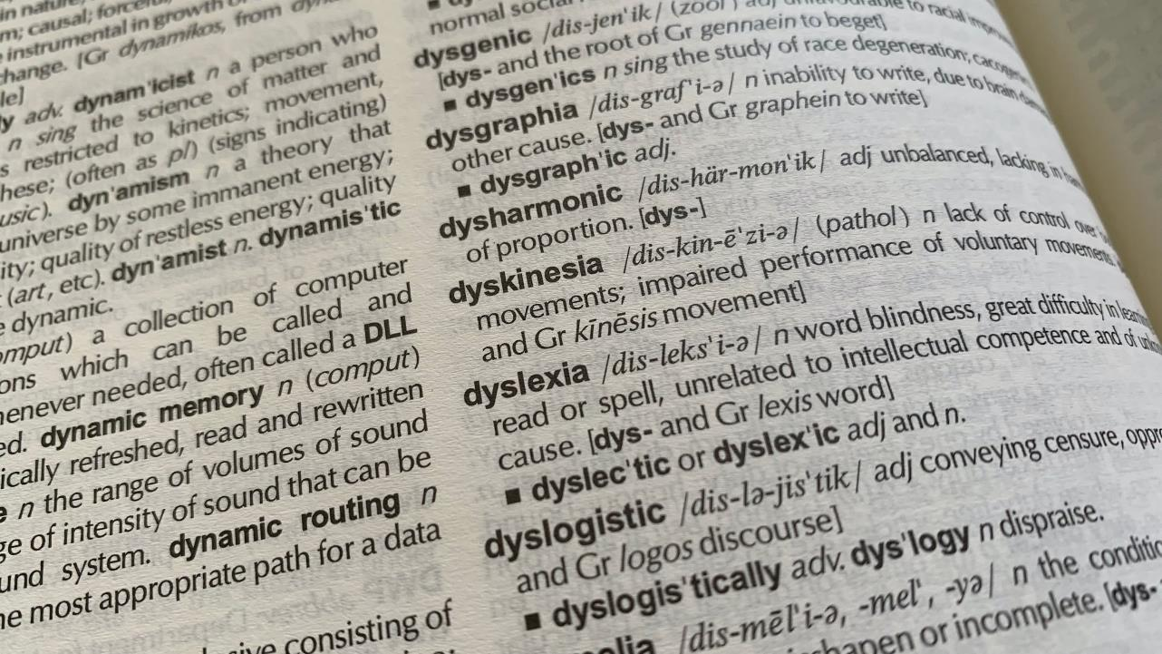
Notes:
Photo by <a href="https://unsplash.com/@rob_hobson?utm_content=creditCopyText&utm_medium=referral&utm_source=unsplash">Rob Hobson</a> on <a href="https://unsplash.com/photos/a-close-up-of-a-book-with-words-on-it-0apZjDdRS5o?utm_content=creditCopyText&utm_medium=referral&utm_source=unsplash">Unsplash</a>
Are they dyslexic?

Slide 92

Notes:
Photo by <a href="https://unsplash.com/@mango_quan?utm_content=creditCopyText&utm_medium=referral&utm_source=unsplash">Harry Quan</a> on <a href="https://unsplash.com/photos/close-up-photography-of-rainbow-rays-on-eye-G1iYCeCW2EI?utm_content=creditCopyText&utm_medium=referral&utm_source=unsplash">Unsplash</a>
Are they colour blind?

Slide 93

Notes:
Photo by <a href="https://unsplash.com/@nickpage?utm_content=creditCopyText&utm_medium=referral&utm_source=unsplash">Nick Page</a> on <a href="https://unsplash.com/photos/a-close-up-of-a-sign-on-a-building-xJePstYD8Pg?utm_content=creditCopyText&utm_medium=referral&utm_source=unsplash">Unsplash</a>
How are they feeling when looking at your data visualization?

Slide 94

Notes:
Photo by <a href="https://unsplash.com/@brett_jordan?utm_content=creditCopyText&utm_medium=referral&utm_source=unsplash">Brett Jordan</a> on <a href="https://unsplash.com/photos/brown-wooden-blocks-on-white-surface-hjI67-48t5I?utm_content=creditCopyText&utm_medium=referral&utm_source=unsplash">Unsplash</a>
What might they want to achieve with the data viz
Save money
Detect poor performance
Check have enough money in the bank

Slide 95

Notes:
Photo by Kindel Media: https://www.pexels.com/photo/woman-in-red-top-pointing-on-the-graph-7688455/
When different personas look at different visualisations what will they see

Slide 96

Notes:
You have been asked to create a dashboard

Slide 97
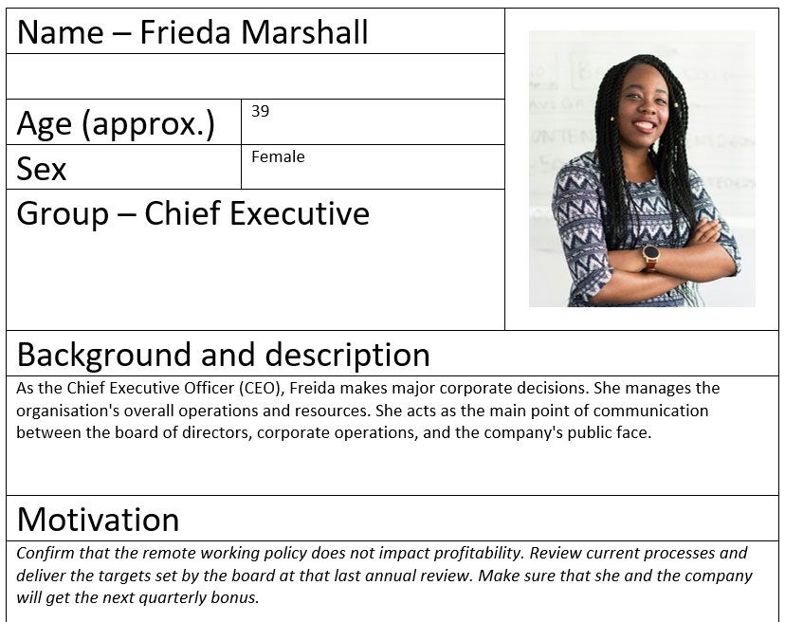

Slide 98
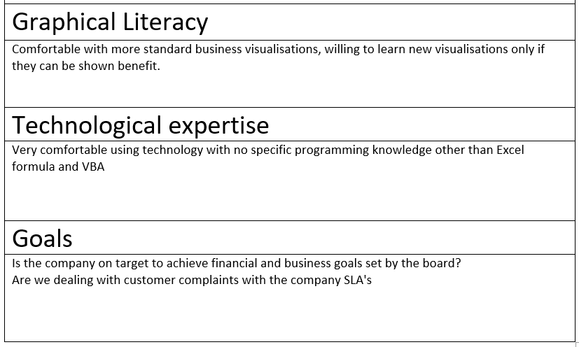

Slide 99

Notes:
What will the CEO be looking for on her dashboard

Slide 100
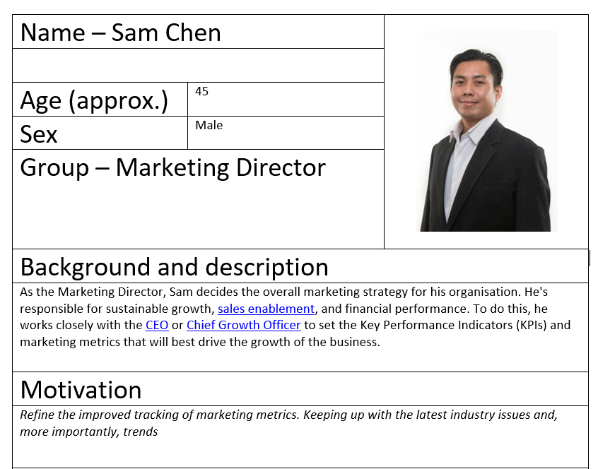

Slide 101
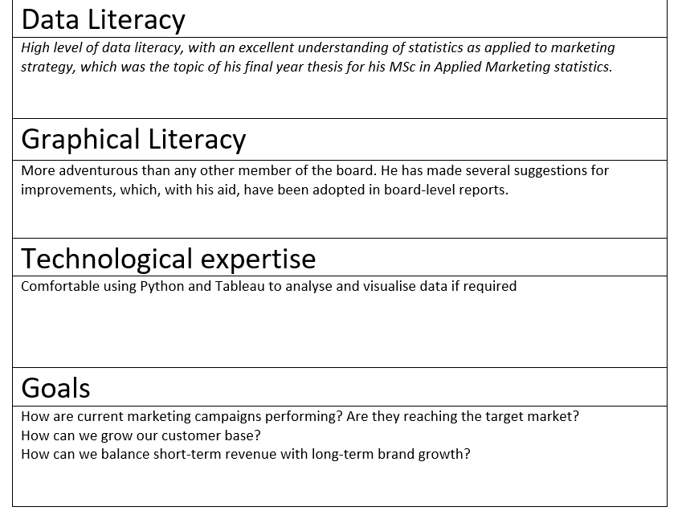

Slide 102
Notes:
What will the Marketing be looking for on his dashboard

Slide 103
Physiology

Slide 104

Notes:
Photo by Christina @ wocintechchat.com
Humans and the human body are quite amazing

Slide 105

Notes:
Photo by Womanizer Toys on Unsplash
Hands and what they can do a is just amazing if you think about it

Slide 106
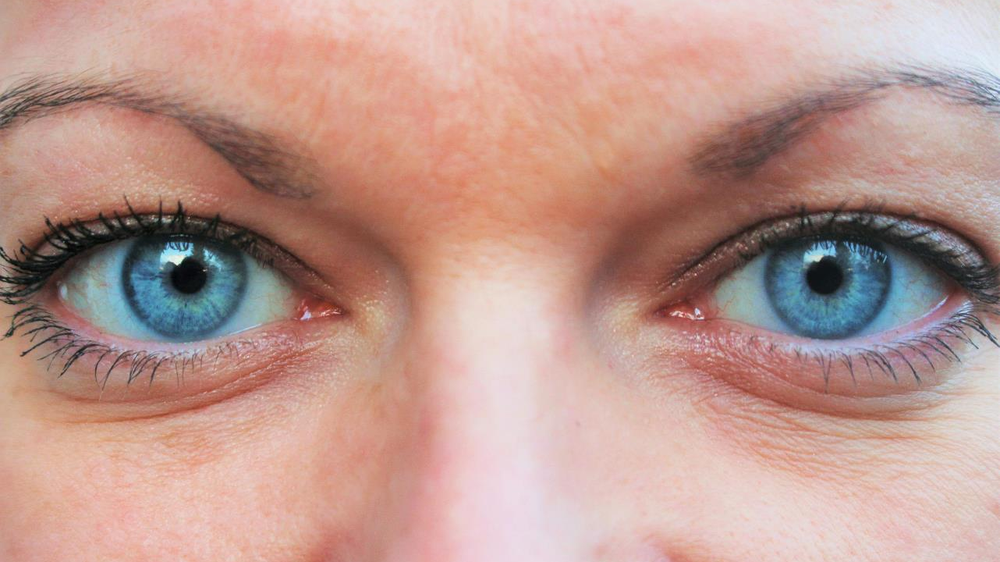
Notes:
Photo by Laurent Jollet on Unsplash
Eyes are one part of our body I want to talk about in a little more detail

Slide 107
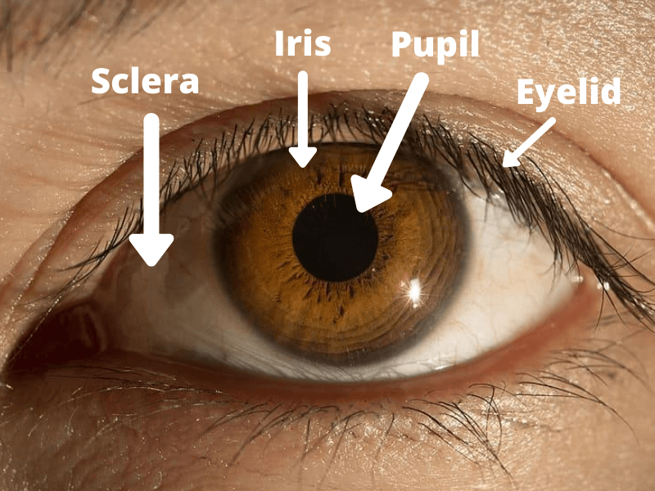
https://smartclass4kids.com/human-eye-diagram/

Slide 108
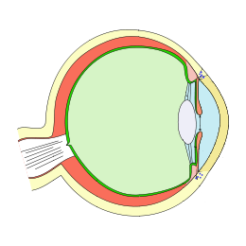


By Pereru - Extracted from this Commons file, CC BY-SA 3.0, https://commons.wikimedia.org/w/index.php?curid=90048792
Notes:
By Pereru - Extracted from this Commons file, CC BY-SA 3.0, https://commons.wikimedia.org/w/index.php?curid=90048792

Slide 109
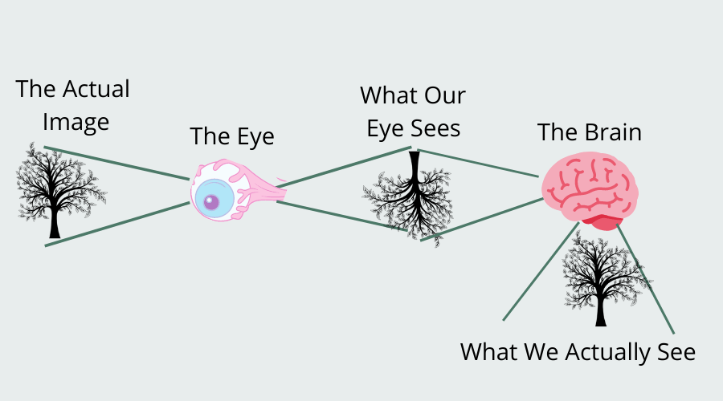
https://smartclass4kids.com/human-eye-diagram/

Slide 110

Simple
Notes:
Simple yes ?

Slide 111

Notes:
Photo by Kelly Sikkema on Unsplash
So Robert this the all very boring I know all this already

Slide 112
Well actually……

Slide 113

Notes:
Photo by Gemma Evans on Unsplash

Slide 114
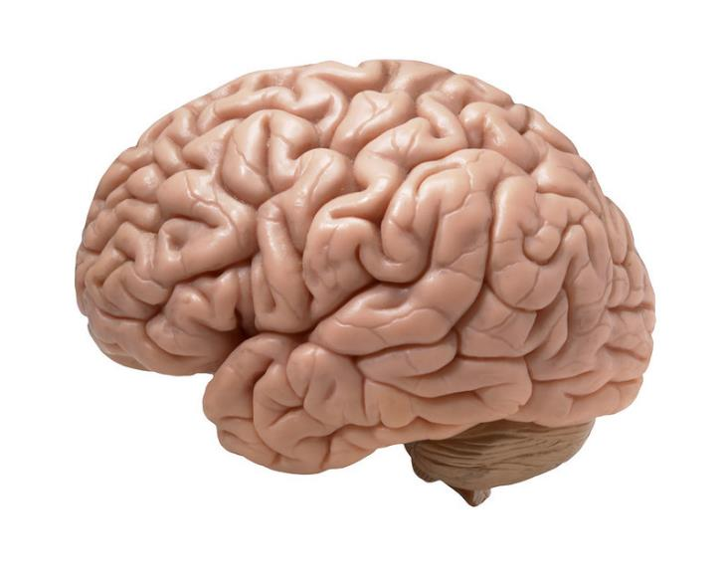
https://www.flickr.com/photos/flamephoenix1991/8376271918
Notes:
https://www.flickr.com/photos/flamephoenix1991/8376271918
We actually see with our brains and it does a lot of work to fool us

Slide 115
Stimulus
Sensory Organ
Perceptual Organ
https://smartclass4kids.com/human-eye-diagram/

Slide 116
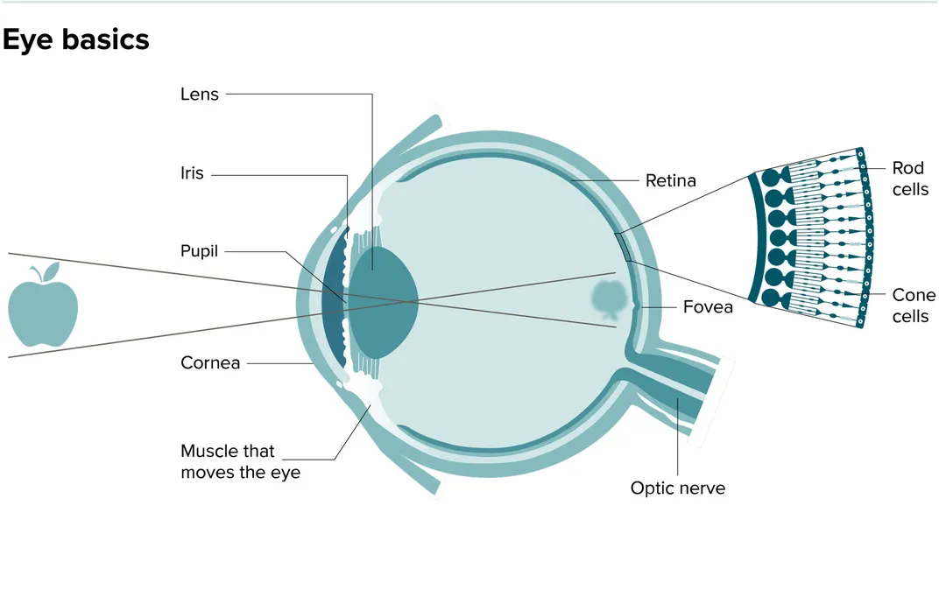
https://www.smithsonianmag.com/science-nature/our-eyes-are-always-darting-around-s-not-how-we-see-world-180972414/
Notes:
https://www.smithsonianmag.com/science-nature/our-eyes-are-always-darting-around-s-not-how-we-see-world-180972414/

Slide 117

Fovea and the fixations
Notes:
Photo by Lina Kivaka: https://www.pexels.com/photo/woman-reading-book-to-toddler-1741231/
Yes I am going to simply a lot of this, if you want to know more then there are links in the git hub repo.
If I get this wrong please come and tell me after the session.

Slide 118
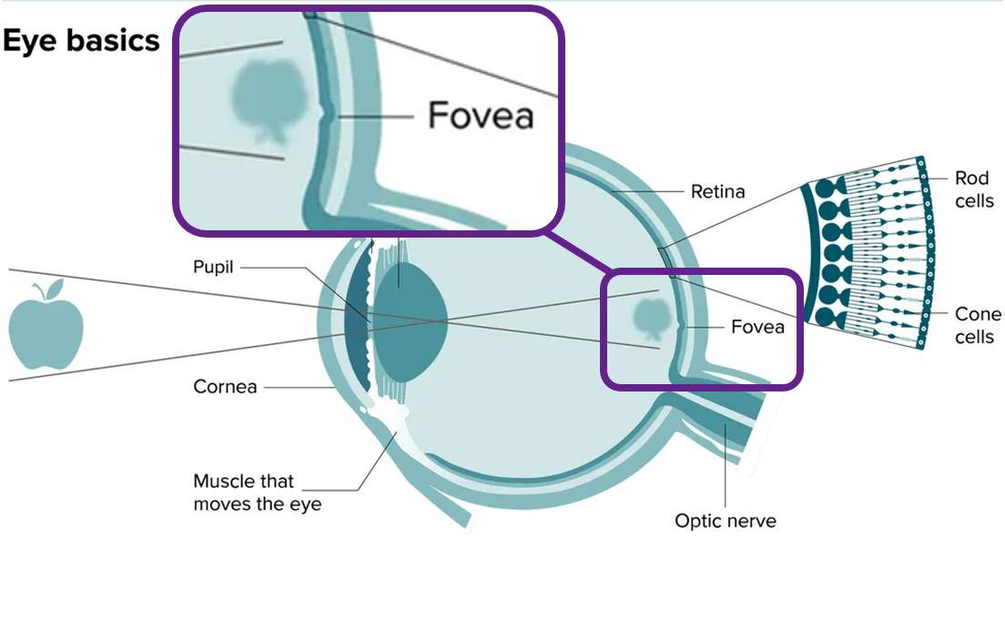
Notes:
https://www.smithsonianmag.com/science-nature/our-eyes-are-always-darting-around-s-not-how-we-see-world-180972414/
The fovea is the part of the eye where the clearest image is focused. Any other part of the retina the image is slightly blurry

Slide 119


Slide 120

Fixation 1

Slide 121

Fixation 2

Slide 122

Fixation 3

Slide 123

Fixation 4

Slide 124

Fixation 5

Slide 125


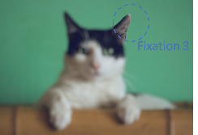
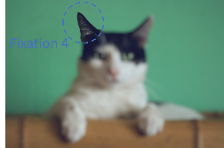
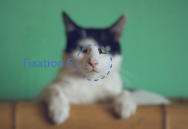


https://www.flickr.com/photos/flamephoenix1991/8376271918
Notes:
https://www.flickr.com/photos/flamephoenix1991/8376271918
We actually see with our brains and it does a lot of work to fool us

Slide 127

Notes:
Photo by Ann H: https://www.pexels.com/photo/letters-on-dice-15387083/
There’s more

Slide 128

Secrets of Saccades
Revealed
Notes:
Photo by Kampus Production: https://www.pexels.com/photo/woman-reading-with-her-granddaughter-6248423/

Slide 129
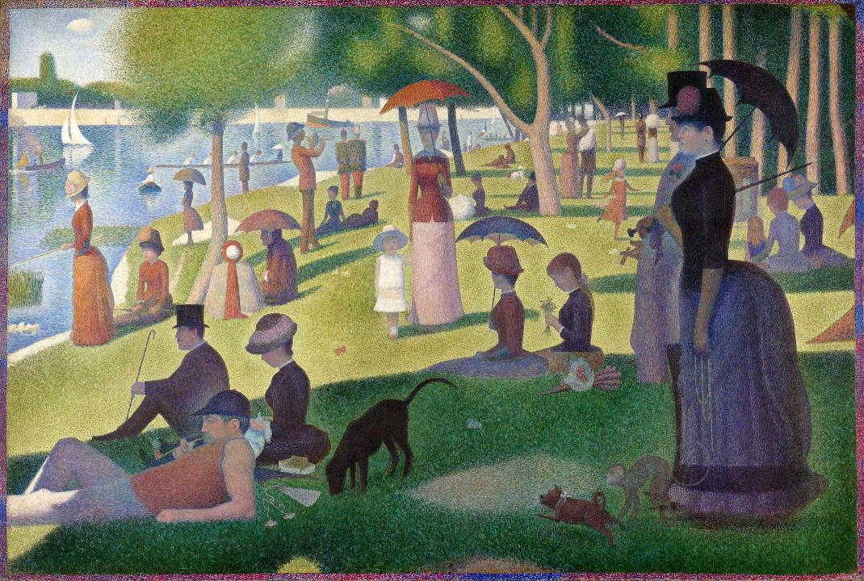
Notes:
https://artsandculture.google.com/asset/a-sunday-on-la-grande-jatte/twGyqq52R-lYpA?hl=en-GB
By Georges Seurat - https://www.bostonglobe.com/arts/theater-dance/2016/09/01/huntington-two-georges-one-sondheim/OR1D4DPM8GsME67aXEjWiP/story.html, Public Domain, https://commons.wikimedia.org/w/index.php?curid=11500785
“A Sunday Afternoon on the Island of La Grande Jatte”

Slide 130
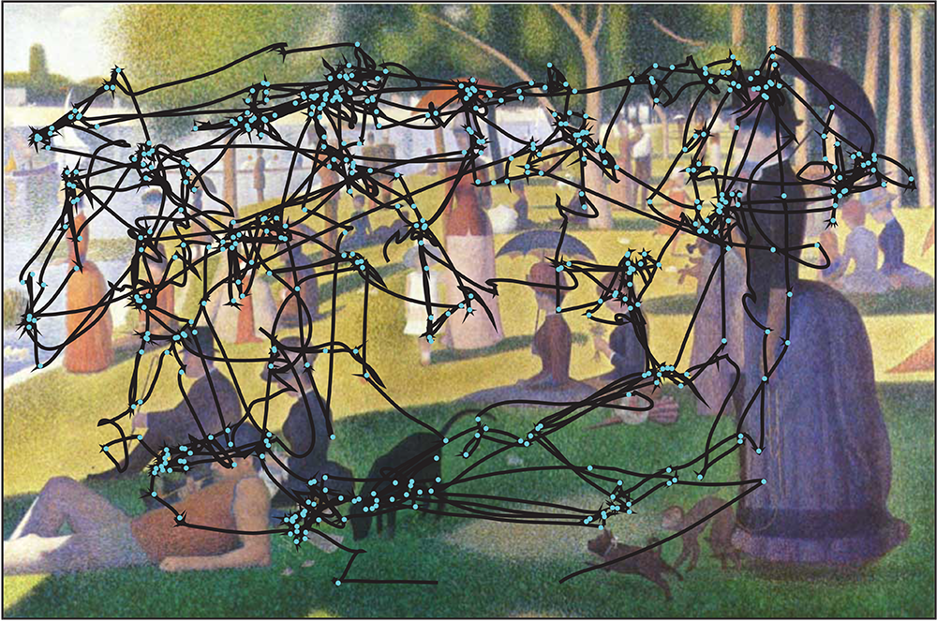
R. Wurtz / Daedalus 2015 / Public Domain
Notes:
R. Wurtz / Daedalus 2015 / Public Domain

Slide 131
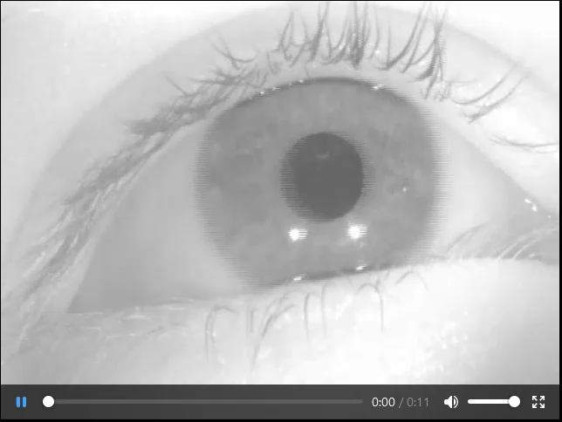
Notes:
https://en.wikipedia.org/wiki/File:This_shows_a_recording_of_the_eye_movements_of_a_participant_looking_freely_at_a_picture.webm

Slide 132
R. Wurtz / Daedalus 2015 / Public Domain
Notes:
R. Wurtz / Daedalus 2015 / Public Domain

Slide 133

Notes:
Photo by <a href="https://unsplash.com/@helloimnik?utm_content=creditCopyText&utm_medium=referral&utm_source=unsplash">Nik</a> on <a href="https://unsplash.com/photos/a-crossword-block-with-the-letter-y-on-it-3NR3ws6Wwj0?utm_content=creditCopyText&utm_medium=referral&utm_source=unsplash">Unsplash</a>

Slide 134
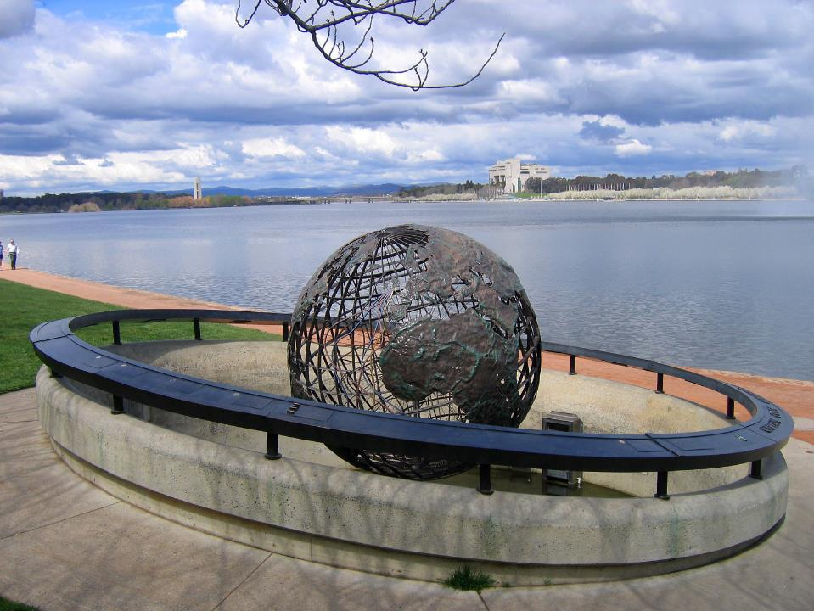
Notes:
https://en.wikipedia.org/wiki/Change_blindness

Slide 135
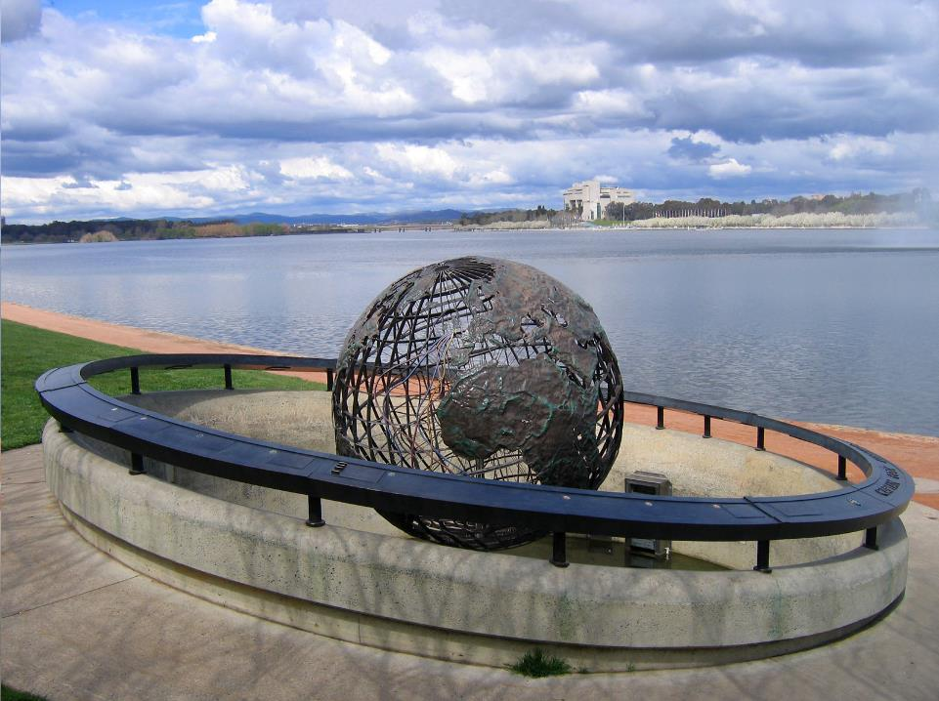
Notes:
https://en.wikipedia.org/wiki/Change_blindness

Slide 136
And?
So what?
Notes:
Some might be saying this in their head

Slide 137
Z scanning

Slide 138





Slide 139
F
scanning

Slide 141
Most important information
Second most important information
Third most important information
Least important information

Slide 142
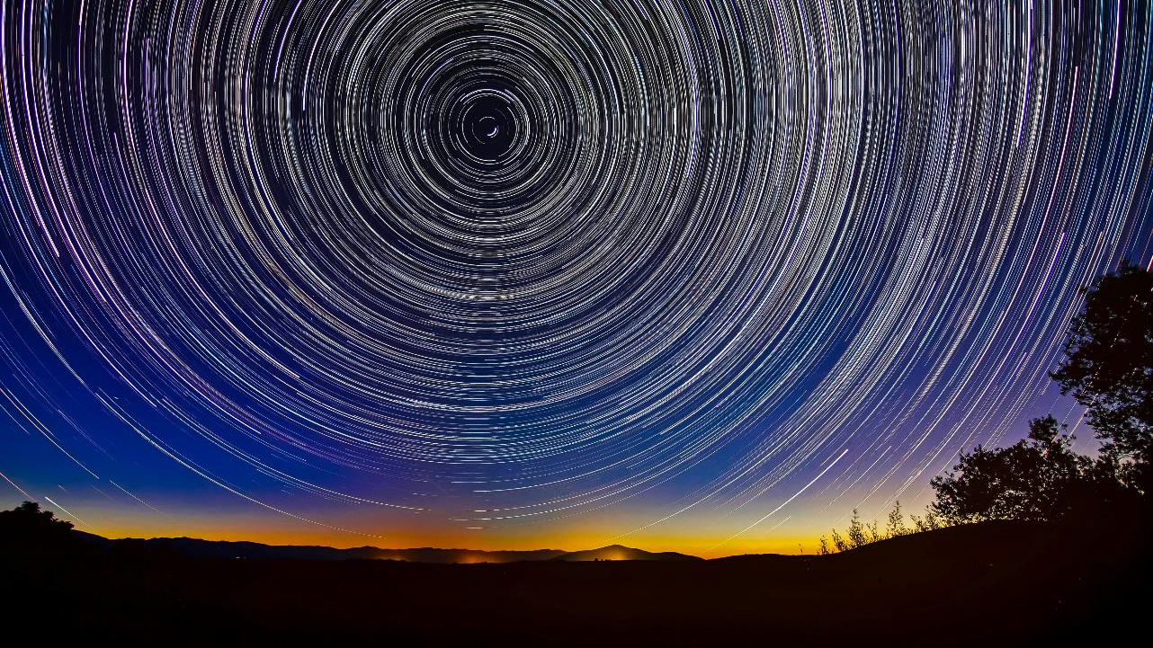
Back to the Fovea
Notes:
Photo by <a href="https://unsplash.com/@paniscusbcn?utm_content=creditCopyText&utm_medium=referral&utm_source=unsplash">Josep Castells</a> on <a href="https://unsplash.com/photos/silhouette-photography-of-trees-and-sky-88dIGET-nTg?utm_content=creditCopyText&utm_medium=referral&utm_source=unsplash">Unsplash</a>

Slide 143
Notes:
https://www.smithsonianmag.com/science-nature/our-eyes-are-always-darting-around-s-not-how-we-see-world-180972414/
The fovea is the part of the eye where the clearest image is focused. Any other part of the retina the image is slightly blurry

Slide 144
the fovea…contains 200 times more colour photoreceptors (cones) than anywhere else in the eye

Slide 146

Notes:
Photo by wu yi on Unsplash
Test time going to time you to see how long it takes to complete this task

Slide 147
Instructions
Count how many 9 on next slide

Slide 148
1 3 9 3 3 7 7 0 1 9 7 5 5
9 5 0 3 1 3 2 0 3 3 7 8 9
3 3 1 7 9 5 5 0 5 1 5 9 6
5 2 4 8 2 3 4 5 6 3 5 1 9
7 0 1 3 1 0 1 3 2 1 7 3 4
1 9 4 9 3 1 5 2 4 1 3 1 9
3 5 0 8 4 8 2 6 8 8 5 2 2
3 1 5 1 5 3 9 1 0 1 7 9 5
3 3 3 6 1 7 0 1 2 7 1 3 0

Slide 149

How many 9's did you count?
ⓘ Start presenting to display the poll results on this slide.

Slide 150

Notes:
Photo by Nguyen Dang Hoang Nhu on Unsplash
Did that feel like a test?

Slide 151
Instructions
Count how many 9 on next slide

Slide 152
1 3 9 3 3 7 7 0 1 9 7 5 8
9 5 0 3 1 3 2 0 3 3 7 9 2
3 3 1 7 9 5 5 0 5 1 5 9 6
5 2 4 8 2 3 4 5 6 9 5 1 7
7 0 1 9 1 0 1 3 2 1 7 3 4
1 5 4 3 3 1 5 2 9 1 3 1 4
3 5 0 9 4 8 2 6 8 8 5 2 2
3 1 5 1 5 3 9 0 0 1 7 1 9
3 3 9 6 1 7 9 1 2 7 1 3 0

Slide 153
How many 9's did you count?
ⓘ Start presenting to display the poll results on this slide.

Slide 154

Notes:
Photo by Ben White on Unsplash
Did that version seem easier?
No the nines where not all in the same place ;-)

Slide 155
Pre attentive attributes

Slide 156

Notes:
Some of you have questions
Why is he doing this?
Why did the colour make it much easier

Slide 157

Notes:
Colin Ware in his book Information visualisation for design

Slide 158
https://bit.ly/Make_My_Report_Pop

Slide 159
Form

Slide 160
Length

Slide 161
Width

Slide 162
Orientation

Slide 163
Curvature

Slide 164
Size

Slide 165
Shape

Slide 166
Added Marks

Slide 167
Enclosure

Slide 168
Blur

Slide 169
Spatial Grouping

Slide 170
Colour

Slide 171
Hue

Slide 172
Intensity

Slide 173
Spatial
Position

Slide 174
2D Position

Slide 175

Notes:
Photo by Robert Nagy: https://www.pexels.com/photo/puzzled-gamer-in-illuminated-room-3930070/

Slide 176

Website survey results
Notes:
Here is some website survey results

Slide 177
What are the best performers?

Slide 178



Slide 179
What are the worst performers?

Slide 180


Slide 181

Notes:
Photo by Markus Winkler on Unsplash

Slide 182


Slide 184
£1.10p
Costs £1.00 more than the ball
How much does the ball cost?
Notes:
CRT question 1: This question required respondents to evaluate the cost of a ball given that the total cost of a bat and a ball was $1.10 and the bat cost $1.00 more than the ball. An intuitive (impulsive) answer that the ball costs $0.10 does spring to mind by subtracting $1.00 from $1.10. However, should this be the case, the total cost of the bat and ball would be $1.20, which is incorrect. Hence, the right answer is $0.05

Slide 185

How much does the ball cost? (first answer that comes to mind)
ⓘ Start presenting to display the poll results on this slide.

Slide 186
If ball costs 10p
If bat costs £1.00 more than ball
Bat must cost £1.10
£1.20p
£1.10
£0.10
Notes:
CRT question 1: This question required respondents to evaluate the cost of a ball given that the total cost of a bat and a ball was $1.10 and the bat cost $1.00 more than the ball. An intuitive (impulsive) answer that the ball costs $0.10 does spring to mind by subtracting $1.00 from $1.10. However, should this be the case, the total cost of the bat and ball would be $1.20, which is incorrect. Hence, the right answer is $0.05

Slide 187


Slide 188
Ball costs 5p
If bat costs £1.00 more than ball
Bat must cost £1.05
£1.10p
£1.05
£0.05
Notes:
CRT question 1: This question required respondents to evaluate the cost of a ball given that the total cost of a bat and a ball was $1.10 and the bat cost $1.00 more than the ball. An intuitive (impulsive) answer that the ball costs $0.10 does spring to mind by subtracting $1.00 from $1.10. However, should this be the case, the total cost of the bat and ball would be $1.20, which is incorrect. Hence, the right answer is $0.05

Slide 189


Slide 190

Notes:
https://en.wikipedia.org/wiki/Checker_shadow_illusion

Slide 191
Is Square A and B same colour
ⓘ Start presenting to display the poll results on this slide.

Slide 192

Notes:
https://en.wikipedia.org/wiki/Checker_shadow_illusion

Slide 193

Notes:
https://en.wikipedia.org/wiki/Checker_shadow_illusion

Slide 194

Notes:
https://en.wikipedia.org/wiki/Checker_shadow_illusion

Slide 195

Notes:
Photo by viswaprem anbarasapandian on Unsplash

Slide 196
The lily patch doubles in size each day.
Notes:
Photo by viswaprem anbarasapandian on Unsplash

Slide 197
Takes 48 days to cover entire pond with lilies.
Notes:
Photo by viswaprem anbarasapandian on Unsplash

Slide 198
How long would it take to cover half the pond?
Notes:
Photo by viswaprem anbarasapandian on Unsplash

Slide 199
How long would it take to cover half the pond? What is first answer you think of?
ⓘ Start presenting to display the poll results on this slide.

Slide 200
On day 47 the lily patch would cover half the pond
So 47 days
Notes:
Photo by viswaprem anbarasapandian on Unsplash

Slide 201

Types of thinking

Slide 202

System one thinking

Slide 203

System two thinking
Notes:
Photo by Dušan veverkolog on Unsplash

Slide 204

Notes:
Photo by Ruthson Zimmerman on Unsplash
System one and system two work together, this is something that should be remember when creating visualsations

Slide 205

Notes:
Photo by <a href="https://unsplash.com/@bookerboot?utm_content=creditCopyText&utm_medium=referral&utm_source=unsplash">Ahmed Almakhzanji</a> on <a href="https://unsplash.com/photos/the-new-york-times-book-kshkB1i5_5o?utm_content=creditCopyText&utm_medium=referral&utm_source=unsplash">Unsplash</a>

Slide 206
https://bit.ly/Make_My_Report_Pop

Slide 207
Priming

Slide 208

Notes:
Photo by Nick Fewings on Unsplash

Slide 209



So_p
Notes:
Photo by micheile henderson on Unsplash

Slide 210



So_p
Notes:
https://www.flickr.com/photos/66992990@N00/4818752775 - Butter and knife
Photo by Helio Ha on Unsplash – Orange Juice

Slide 211
Do NOT think about a……

Slide 212


Slide 213


Slide 214


Slide 215


Slide 216


Slide 217

Notes:
Photo by Anna Shvets: https://www.pexels.com/photo/person-holding-silver-round-coins-4226264/
Look at how the brain works

Slide 218

Notes:
Its not easy to learn a new skill
Photo by The Ride Academy on Unsplash

Slide 219

Notes:
How to do we learn? – sometimes we feel there is so much to learn !
Photo by Tim Gouw on Unsplash

Slide 220

Notes:
Two types of memory
Photo by Heliberto Arias on Unsplash

Slide 221

Notes:
Working memory - which is store term more of scratch pad more than anything
Photo by Harrison Broadbent on Unsplash

Slide 222

Notes:
Long term memory – which is where we store
Photo by Azamat Esenaliev from Pexels

Slide 223

Notes:
For the example we are going to assume three slots
Photo by Tony Hand on Unsplash

Slide 224


“Computer Ram”
Slot one
Slot two
Slot three
“Hard Drive”

Slide 225



“Working memory”
Slot one
Slot two
Slot three
“Long Term memory”

Slide 226
“Working memory”
Slot one
Slot two
Slot three
“Long Term memory”

Slide 227

“Working memory”
Slot one
Slot two
Slot three
“Long Term memory”

Slide 228

“Working memory”
Slot one
Slot two
Slot three
“Long Term memory”

Slide 229
“Working memory”
Slot one
Slot two
Slot three
“Long Term memory”

Slide 230


Slide 231

Notes:
https://www.smashingmagazine.com/2016/09/reducing-cognitive-overload-for-a-better-user-experience/

Slide 232


Slide 233

https://uxmag.com/articles/four-cognitive-design-guidelines-for-effective-information-dashboards
Notes:
https://uxmag.com/articles/four-cognitive-design-guidelines-for-effective-information-dashboards

Slide 234

10 Dashboard Design Errors And How To Avoid Them (fusioncharts.com)10 Dashboard Design Errors And How To Avoid Them (fusioncharts.com)

Slide 235


Slide 236

There are only THREE slots in my working memory
Notes:
Photo by Atul Choudhary from Pexels

Slide 237


Slide 238
Gestalt psychology

Slide 239

Notes:
Photo by Natasha Connell on Unsplash
This is about how your brain see things, and makes sense of the world

Slide 240

Gestalt principles

Slide 241
Notes:
So what I’m going to show is a set of dots like this and they will illustrate the different types of gestalt psychology

Slide 242
Proximity

Slide 244
Symmetry

Slide 246
Similarity

Slide 248
Enclosure

Slide 250
Closure

Slide 252
Continuity

Slide 254

Similarity

Slide 255

Anomaly

Slide 256


Slide 257

Notes:
Photo by Andrea Piacquadio: https://www.pexels.com/photo/photo-of-yawning-man-with-his-hands-up-and-eyes-closed-sitting-at-a-table-with-his-laptop-3760538/
That’s all very interesting what has that got to do with real life?

Slide 258

Notes:
Photo by Nick Fewings on Unsplash

Slide 259

Closure
Notes:
Lets look at some real life

Slide 260

Closure
Notes:
Even though the lines are dashed we see them as a whole
Forming a T shape
Showing way around the roundabout

Slide 261

Continuation
Notes:
Your eye is drawn form the A to Z and them along the logo

Slide 262

Continuation

Slide 263

Figure and ground

Slide 264

Figure and ground
By Bryan Derksen - Original image Cup or faces paradox.jpg uploaded by Guam on 28 July 2005, SVG conversion by Bryan Derksen, CC BY-SA 3.0, https://commons.wikimedia.org/w/index.php?curid=1733355
Notes:
Vase or two faces?
By Bryan Derksen - Original image Cup or faces paradox.jpg uploaded by Guam on 28 July 2005, SVG conversion by Bryan Derksen, CC BY-SA 3.0, https://commons.wikimedia.org/w/index.php?curid=1733355

Slide 265

Figure and ground
Notes:
https://www.pinterest.co.uk/pin/15410823713051793/
https://www.ifd.com.br/publicidade-e-propaganda/78-ilustracoes-e-anuncios-geniais-que-usam-o-espaco-negativo/

Slide 266

Notes:
this chart is not following the Gestalt Principle of Continuity

Slide 267

Notes:
Chart rearranged to better follow the Gestalt Principle of Continuity / Continuation

Slide 268

Notes:
Chart rearranged to follow the Gestalt Principles of Continuity and Similarity

Slide 269

Notes:
Anomaly

Slide 270


Number of male vs female employees
Notes:
Similarity

Slide 271


Employees born in UK vs born elsewhere
Notes:
Similarity
Note that there a several levels to this report with are easy to see without being obvious
What are they?

Slide 272

Notes:
Photo by Andrea Piacquadio: https://www.pexels.com/photo/tired-female-student-lying-on-book-in-library-3808080/
Some of you might be thinking nobody uses these techniques in real life

Slide 273


Slide 274

Notes:
Photo by Andrew Neel: https://www.pexels.com/photo/white-flag-2330507/

Slide 275


Slide 276


Slide 277


Slide 278


Slide 279


Slide 280

Notes:
Photo by That's Her Business on Unsplash

Slide 281

Homework
https://youtu.be/hVimVzgtD6w
Notes:
https://youtu.be/hVimVzgtD6w
2:35

Slide 282
10 minute
Break

